Slide 1

Insurance Risks & Claim Analysis
Comprehensive analysis of 18,806 policies revealing risk patterns, claim behavior, and high-cost customer segments across demographics and vehicle characteristics.

Slide 2
Key Metrics at a Glance
18,806
$93.77M
0.51
$5,000
Total Policies
Total Claims
Claim Frequency
Avg Claim Amount
Customer base covered under insurance
Total payout across all claims
Average claim every two years per client
Typical payout per claim
The insured population is large with moderately frequent claims and controlled severity. Gender distribution shows no bias in claim trends.

Slide 3
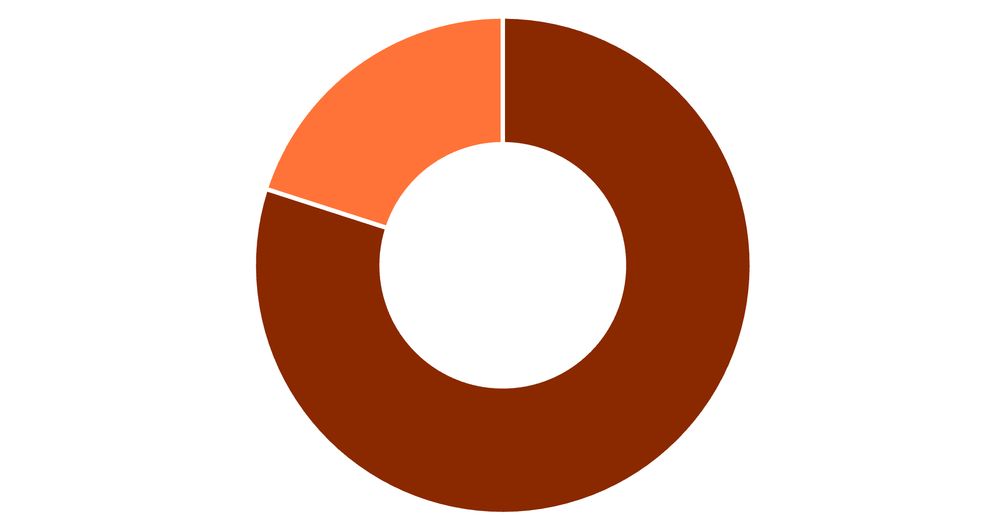
Vehicle Usage Patterns
Private Dominates
Private vehicles account for 80% of claims due to higher volume. Commercial cars show lower count but may represent higher severity per policy.
Recommendation: Track per-policy loss ratio for commercial vehicles.
Private Use
Commercial Use

Slide 4

Top Claim-Generating Brands
Ford
$8.4M in claims
Highest exposure brand requiring model-specific risk review
Chevrolet
$7.4M in claims
Second highest with significant market presence
Toyota
$4.6M in claims
Popular brand with moderate claim volume
GMC
$4.4M in claims
Commercial vehicle exposure driver

Slide 5
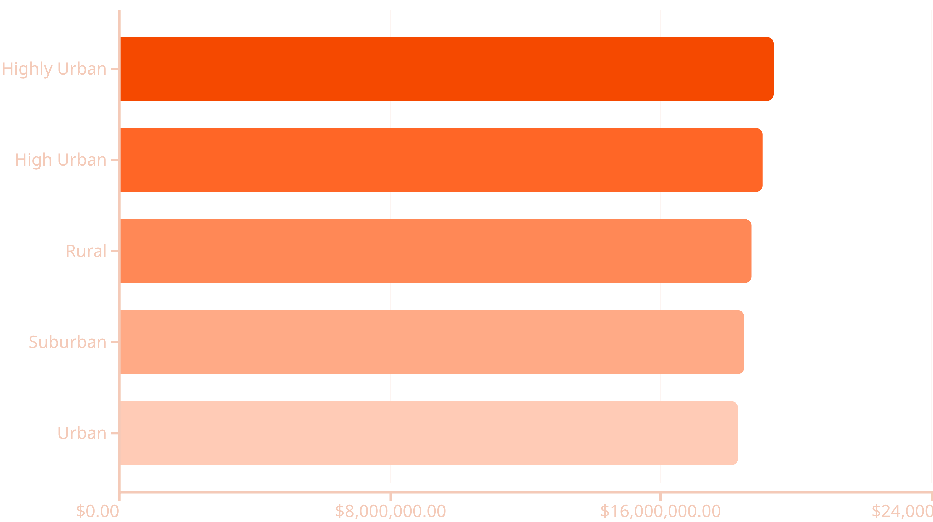
Geographic Risk Distribution
Claims are evenly distributed across zones, but urban and highly urban areas show slightly higher severity due to traffic density and congestion.

Slide 6

Age Groups Drive Different Risk Levels
15-25 Years
$10.3M — Lowest claim volume, possibly due to fewer policies
26-35 Years
$17.7M — High driving frequency begins
36-45 Years
$17.6M — Peak earning and driving years
46-55 Years
$17.6M — Continued high activity
56-65 Years
$17.8M — Highest in age bracket
Middle-aged drivers (26-65) produce approximately 75% of total claims due to higher driving frequency and vehicle ownership.

Slide 7





Critical Risk Factor: Kids Driving
⚠️ High-Risk Alert
Households with kids driving produce $67M in claims during the first year — the single highest risk segment identified.
Premium Adjustments
Increase rates for new young drivers
Driver Education
Mandate training programs
Higher Deductibles
Implement risk-based pricing

Slide 8




Education & Marital Status Impact
Claims by Education
Key Insight
Higher-educated individuals contribute larger claim amounts due to:
More expensive vehicles
Urban living locations
49.7%
Higher policy coverage
Single policyholders show highest claim totals across education levels, while married customers demonstrate more stable risk.
Bachelors
$46.61M in claims
27.8%
High School
$26.08M in claims
15.1%
Masters
$14.16M in claims
6.7%
PhD
$6.33M in claims

Slide 9
Risk Segmentation Summary
High Risk Segments
Low Risk Segments
New young drivers
Very young & seniors
Kids driving households
Ages 15-25 and 66+
Single policyholders
Married drivers
Higher claim amounts
Stable risk profiles
Ages 26-65
PhD-educated
Peak driving frequency
Lowest claim volumes
Ford & Chevrolet
Newer vehicles
Highest brand exposure
Post-2018 models
Urban zones
Rural areas
Traffic density impact
Untapped market potential
Older vehicles
Pre-2018 models

Slide 10
Strategic Recommendations
Pricing & Underwriting
Risk Mitigation
Increase premiums for kids driving households
Driver training discounts for young drivers
Adjust rates for high-traffic urban zones
Safe-driving rewards programs
Risk-based deductibles for older vehicles
Telematics-based monitoring
Customer Strategy
Operations
Loyalty programs for bachelor professionals
Predictive models using car-year trends
Lower premiums for rural markets
Enhanced risk scoring algorithms
Married driver retention incentives
Demographic-based underwriting
Implementing these strategies can significantly reduce claim costs, improve underwriting accuracy, and enhance customer profitability across all segments.

